Slide 1
Zones Grids and EC

Slide 2
Perfection : The Goal ????

Slide 3
Perfection P & K
Immobile P and K
Soil and Crop Driven
First Year evaluate response

Slide 4
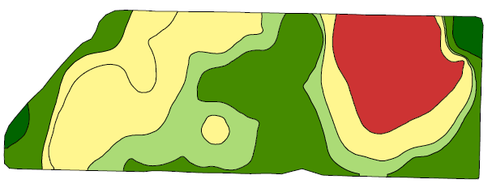
Perfection P & K
Immobile P and K
Rate Studies in each zone
10 lbs
20 lbs
10 lbs
30 lbs
20 lbs
40 lbs
30 lbs
10 lbs
40 lbs
20 lbs
30 lbs
40 lbs

Slide 5
Perfection P & K
Understand the Benefits and Limitations of Soil Testing
Broad sweeping recommendations
Recommendations are Conservative in both directions
Will recommend only when likely to respond
Rate will ensure maximum yield for the majority

Slide 6
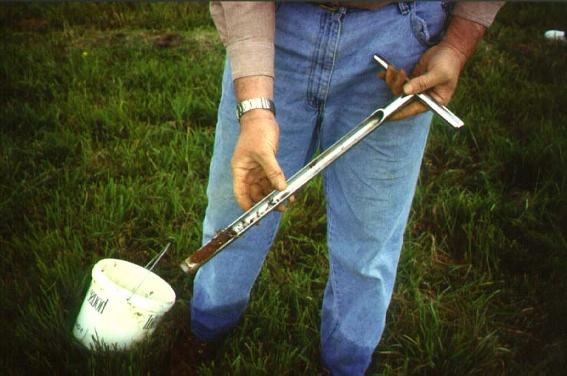
Perfection N
Understand the Benefits and Limitations of Soil Testing
Nitrogen levels in soil are not static
Soil test in August not always relevant in March.
Dependent upon environment and yield level
Multiple yield potentials in the field
Recommendation based on Averages.

Slide 7
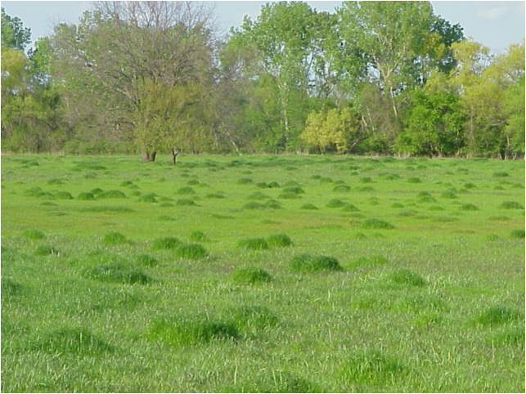
Perfection N
Fields are highly variable
Why apply flat field rate
Why apply even zone level rate

Slide 8
Drawing Lines
Lines for zones based on 1 factor
Yield History
Yield levels
Yield Stability
Topography
Soil Type
Soil EC
Geography / boundaries
Organic Matter
Nutrient levels

Slide 9
Electrical Conductivity (EC)
Soil EC is soil electrical conductivity– a measurement of how much electrical current soil can conduct. It’s an effective way to map soil texture because smaller soil particles such as clay conduct more current than larger silt and sand particles. Soil EC measurements have been used since the early 1900’s-
Veris mobilized the process and added GPS. As the Veris EC cart is pulled through the field, one pair of coulter-electrodes injects a known voltage into the soil, while the other coulter-electrodes measure the drop in that voltage.
The result: a detailed map of the soil texture variability in the crop rooting zone

Slide 10
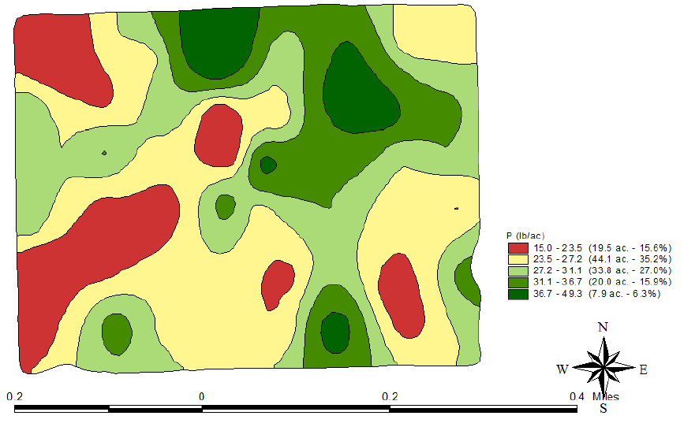
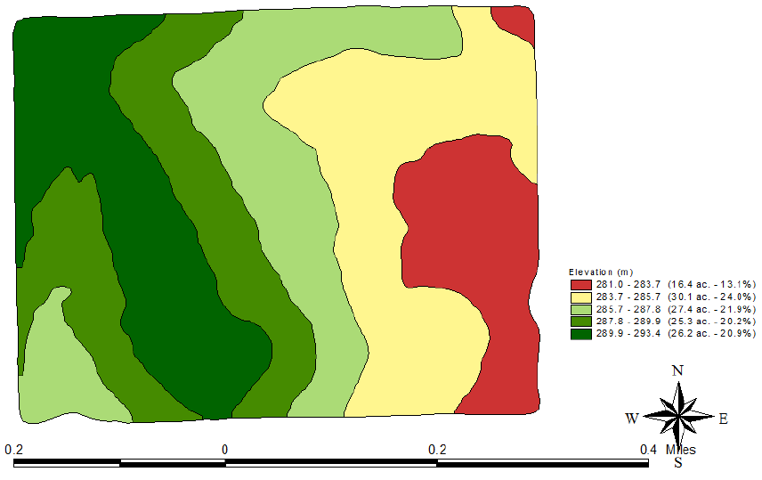
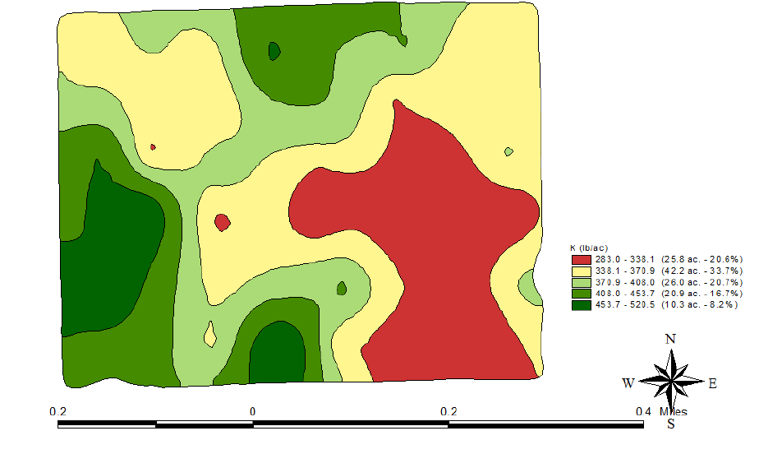
Deteriming the Variable
Using 1 factor to determine other unrelated factors
P
P
K
Elevation

Slide 11
Elevation

Slide 12
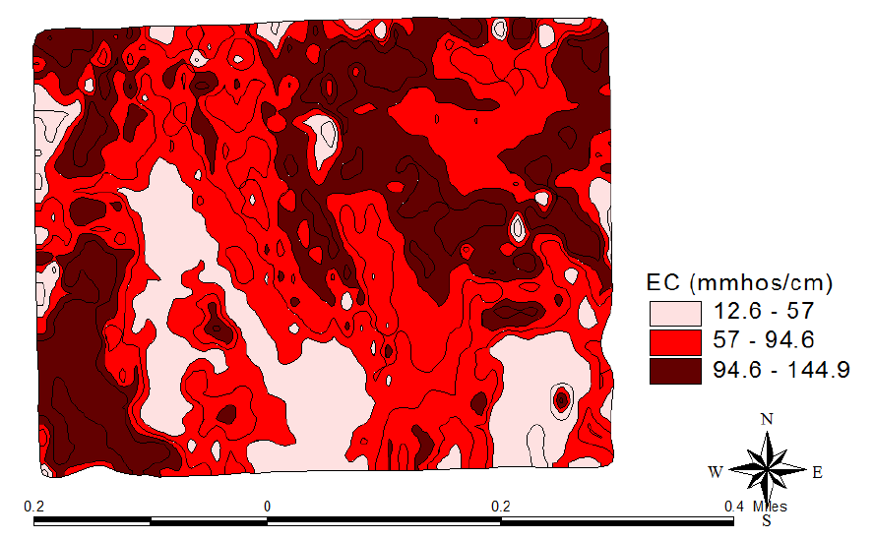
Soil EC

Slide 13
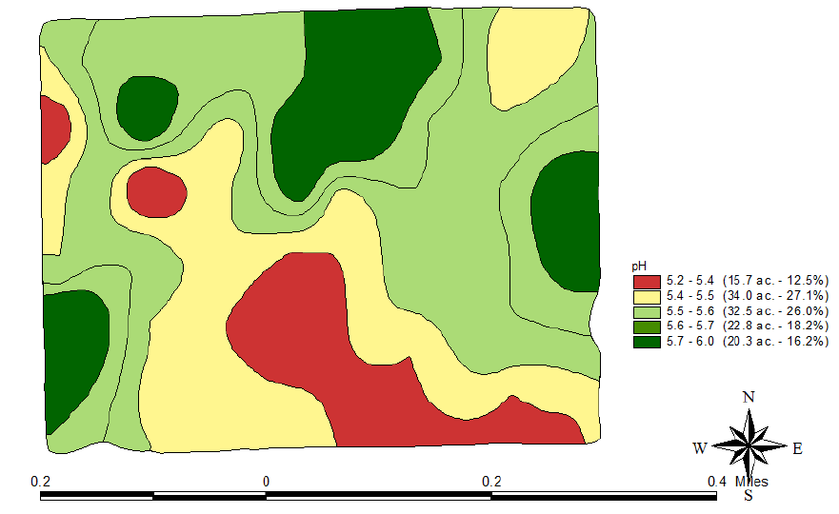
Soil pH

Slide 14
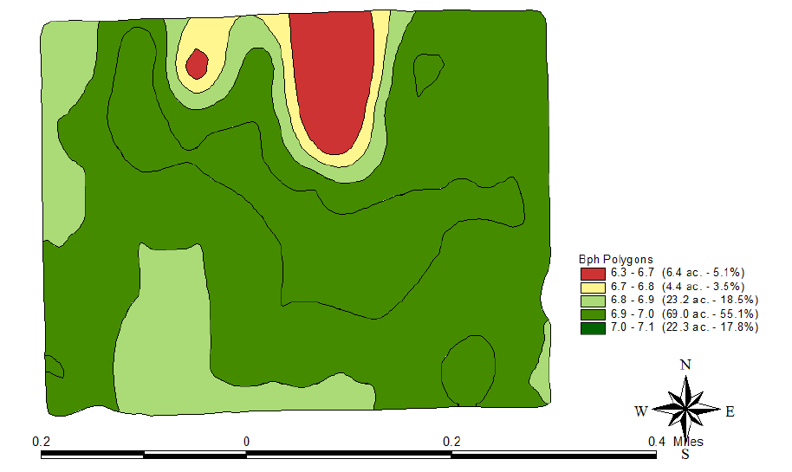
Buffer Index
Buffer Index | Lime required (tons 100% ECCE)
 | pH 6.8 | pH 6.4
Over 7.1 | None | None
7.1 | 0.5 | None
7.0 | 0.7 | None
6.9 | 1.0 | None
6.8 | 1.2 | 0.7
6.7 | 1.4 | 1.2
6.6 | 1.9 | 1.7
6.5 | 2.5 | 2.2
6.4 | 3.1 | 2.7
6.3 | 3.7 | 3.2

Slide 15
Phosphorus
Soil Test P Index | % Sufficiency | P2O5 lbs/ac
0 | 25 | 80
10 | 45 | 60
20 | 80 | 40
30 | 85 | 30
40 | 90 | 20
65+ | 100 | 0

Slide 16
Potassium
Soil Test K Index | % Sufficiency | K2O lbs/ac
0 | 50 | 60
75 | 70 | 50
125 | 80 | 40
200 | 95 | 20
250+ | 100 | 0

Slide 17
Buffer Index
Buffer Index | Lime required (tons 100% ECCE)
 | pH 6.8 | pH 6.4
Over 7.1 | None | None
7.1 | 0.5 | None
7.0 | 0.7 | None
6.9 | 1.0 | None
6.8 | 1.2 | 0.7
6.7 | 1.4 | 1.2
6.6 | 1.9 | 1.7
6.5 | 2.5 | 2.2
6.4 | 3.1 | 2.7
6.3 | 3.7 | 3.2

Slide 18
Phosphorus
Soil Test P Index | % Sufficiency | P2O5 lbs/ac
0 | 25 | 80
10 | 45 | 60
20 | 80 | 40
30 | 85 | 30
40 | 90 | 20
65+ | 100 | 0

Slide 19
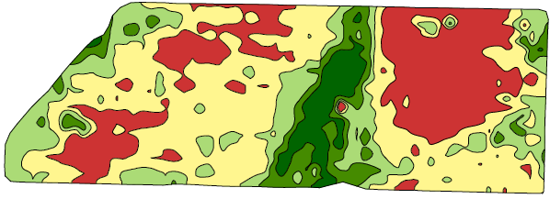
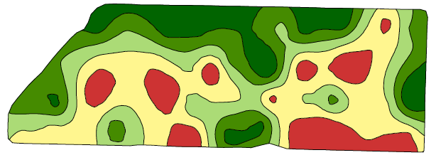
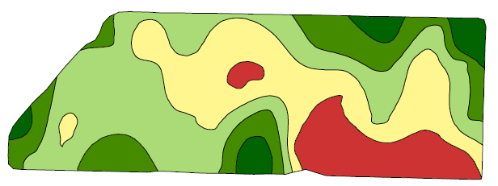
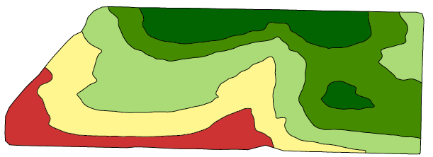
Shallow EC
K
Elevation
Soil pH
P

Slide 20
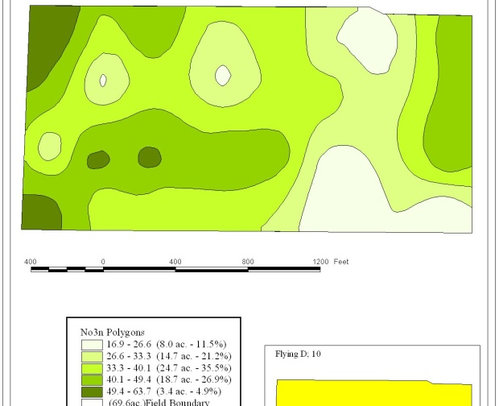
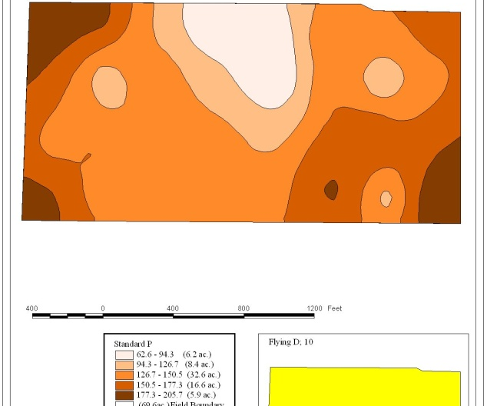
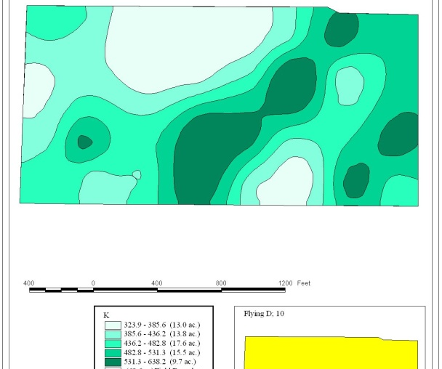
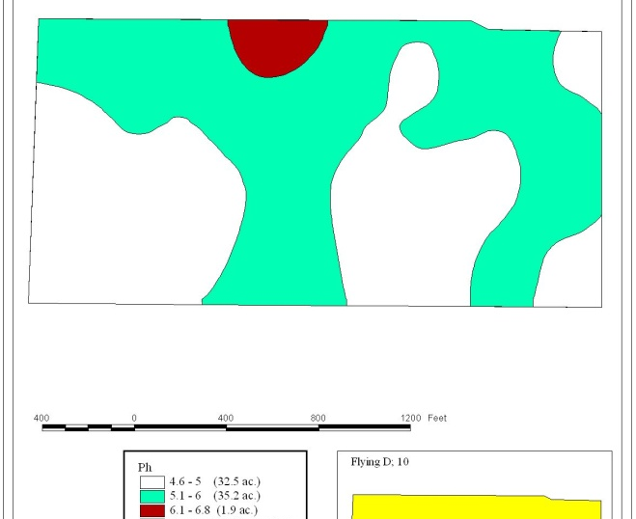
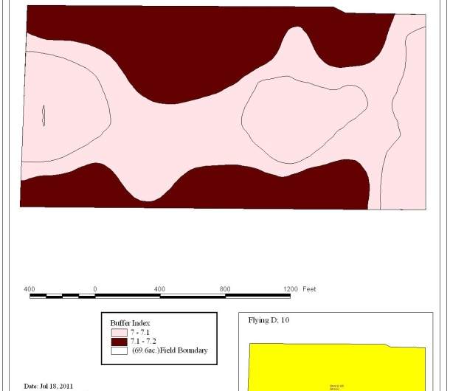

Slide 21
Commercial
Go to web for files.

Slide 22
Identifying Yield Potential and Yield Stability
What can you do with it?
Variable rate seeding and variable rate N for starters

Slide 23
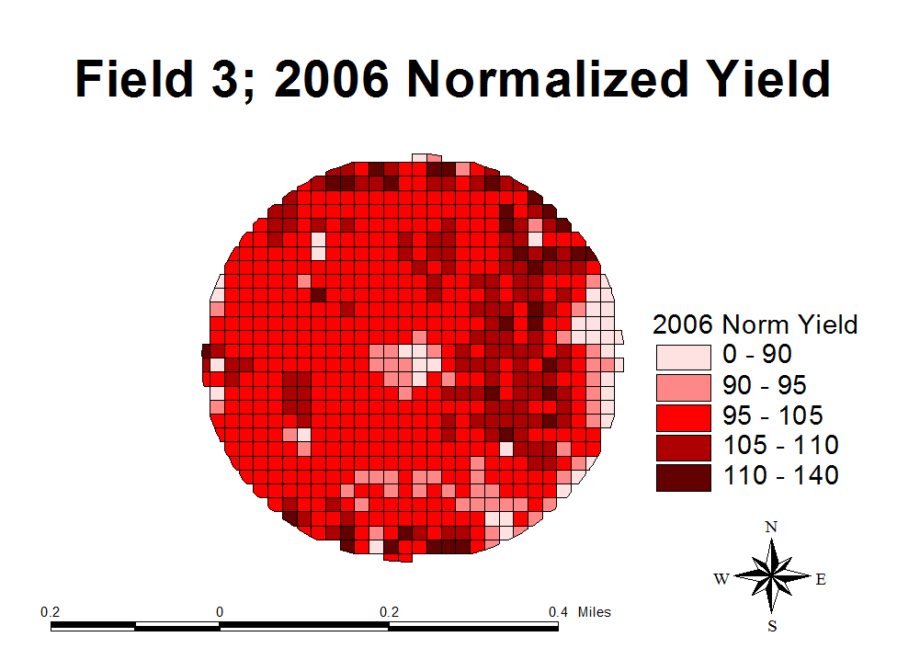

Slide 24
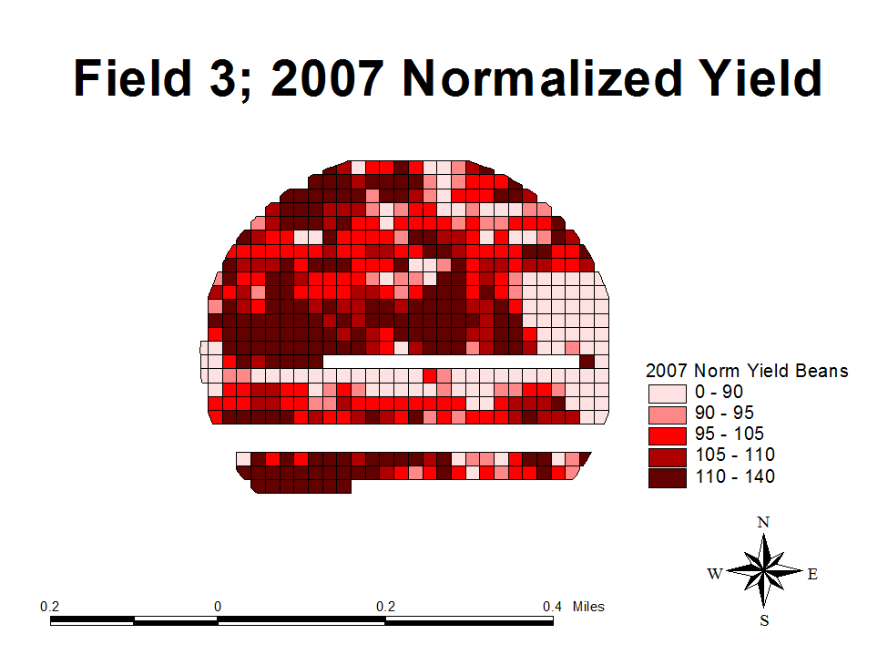

Slide 25
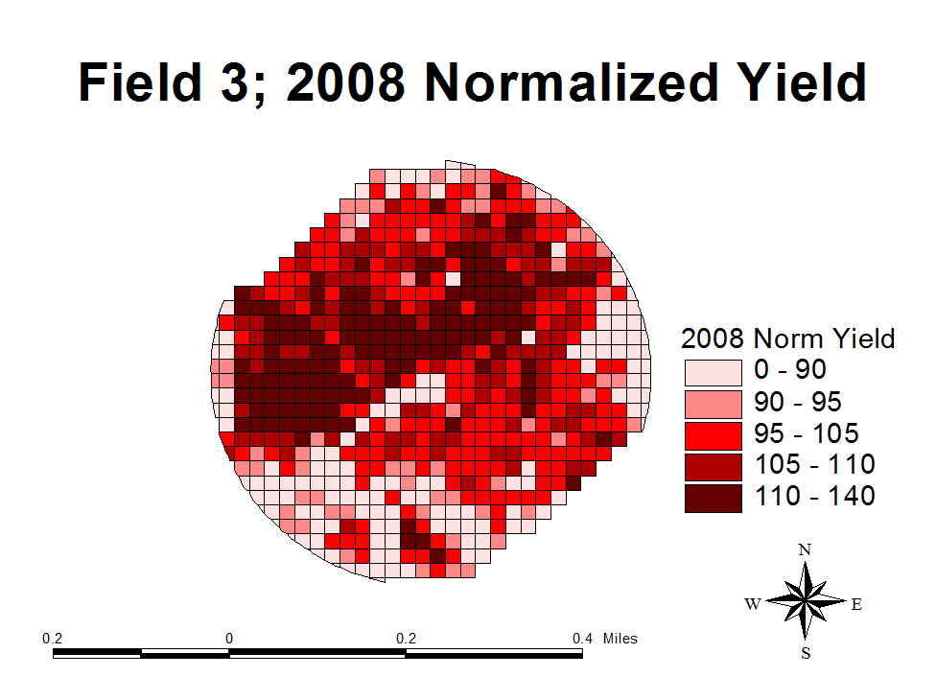

Slide 26
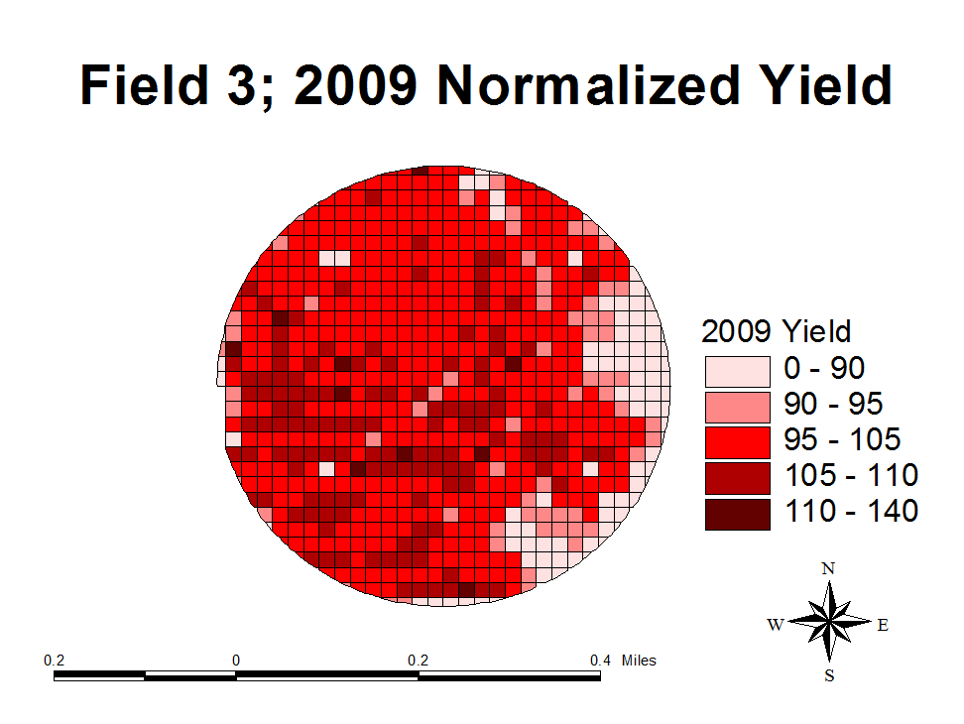

Slide 27
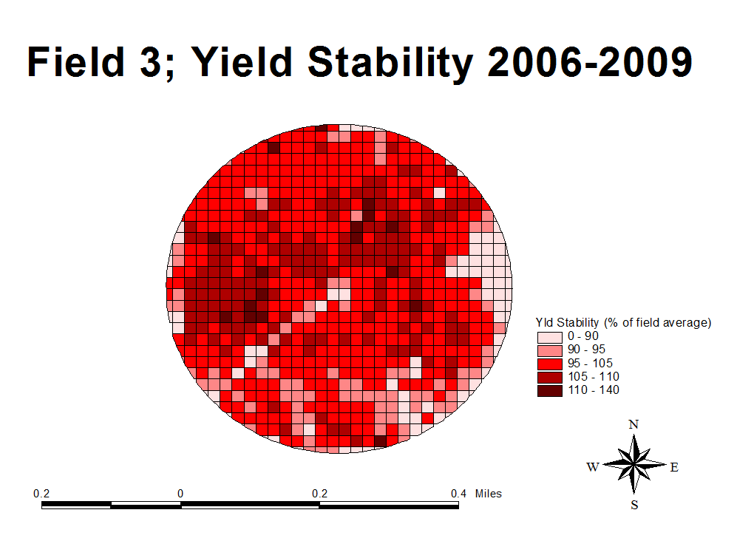

Slide 28
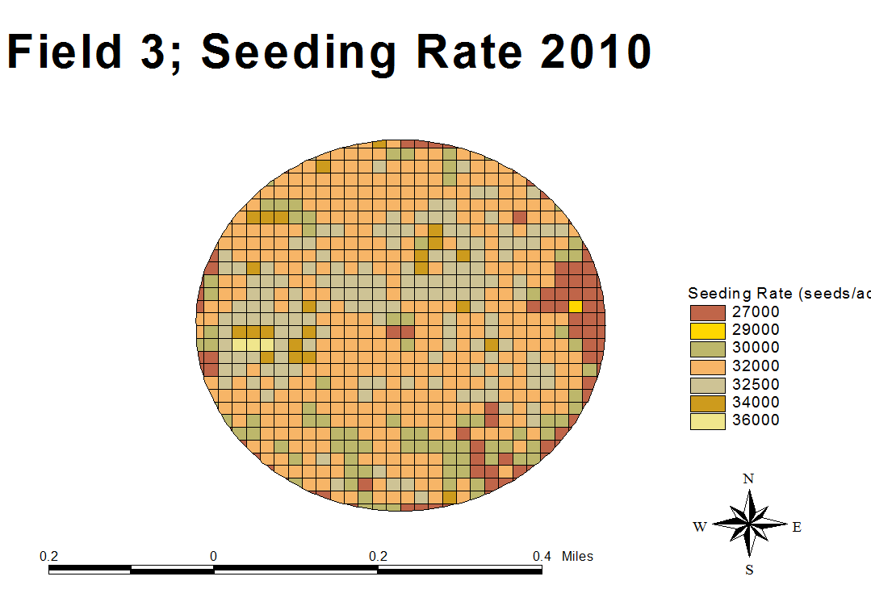
Population Strips. These will be evaluated with yield monitor.

Slide 30
Summary
All techniques are potentially the right way and the wrong way.
MUST have variability before you treat for variability!
Variable Rate Lime, Most economical.
Sometimes Nutrient needs are the same sometimes its not, more often its not.
Look at the cost of the method versus the economics of the production system.

