Slide 1
Nutrient Deficiencies
March 3 Centra

Slide 2
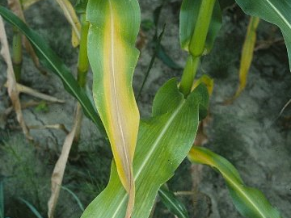
Nitrogen Deficiency
Nitrogen is mobile in the Plant : Lower/Older Leaves
Yellow from the tip toward the mid rib

Slide 3
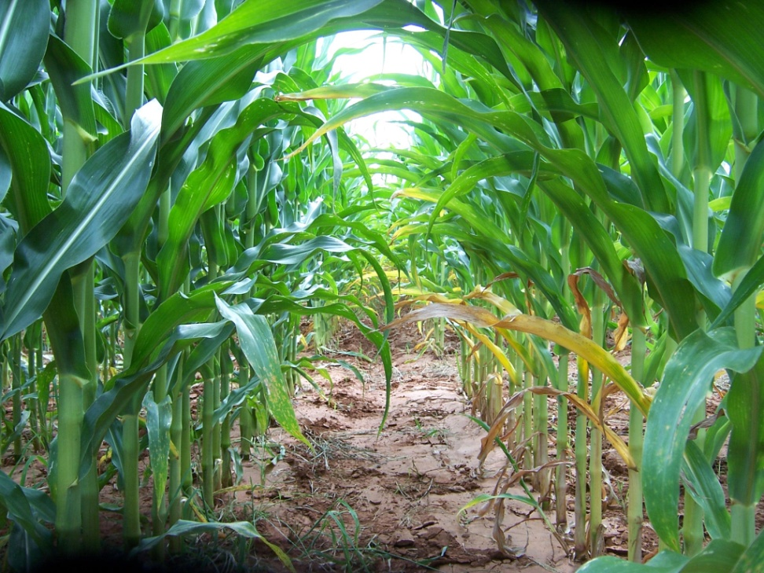
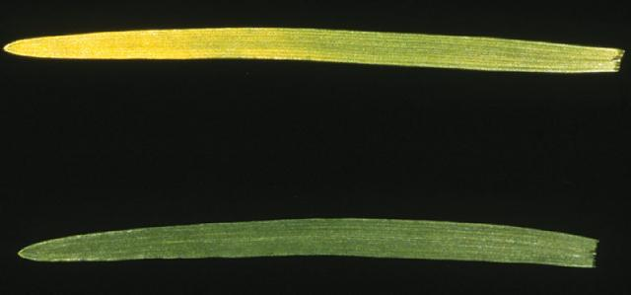

Slide 4
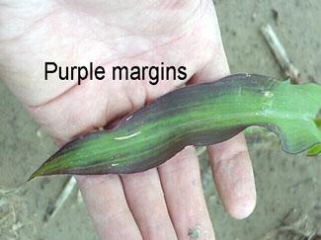
Phosphorus Deficiency
Phosphorus is mobile in the plant: Lower/Older Leaves
Purpling of the leaf margins or base of stems.
Symptoms similar too…
Acidic soils

Slide 5
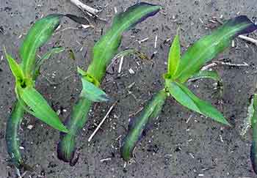
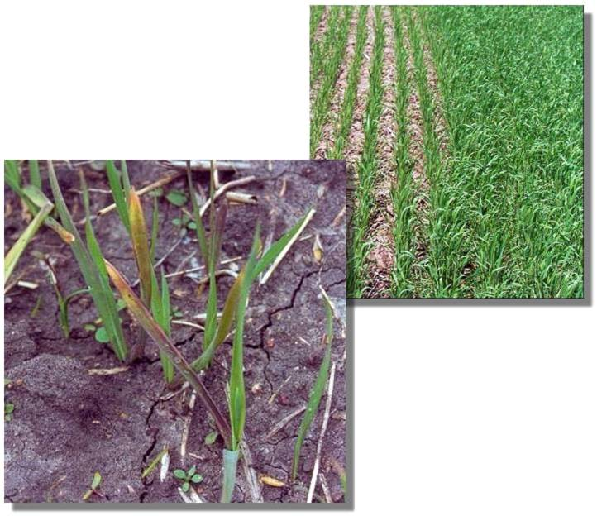

Slide 6
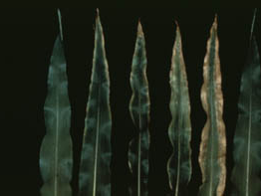
Potassium Deficiency
Potassium is mobile in the plant: Lower/Older Leaves
Yellow starting at the tip advancing along the leaf margins
Brown Scorching along outer margins

Slide 7
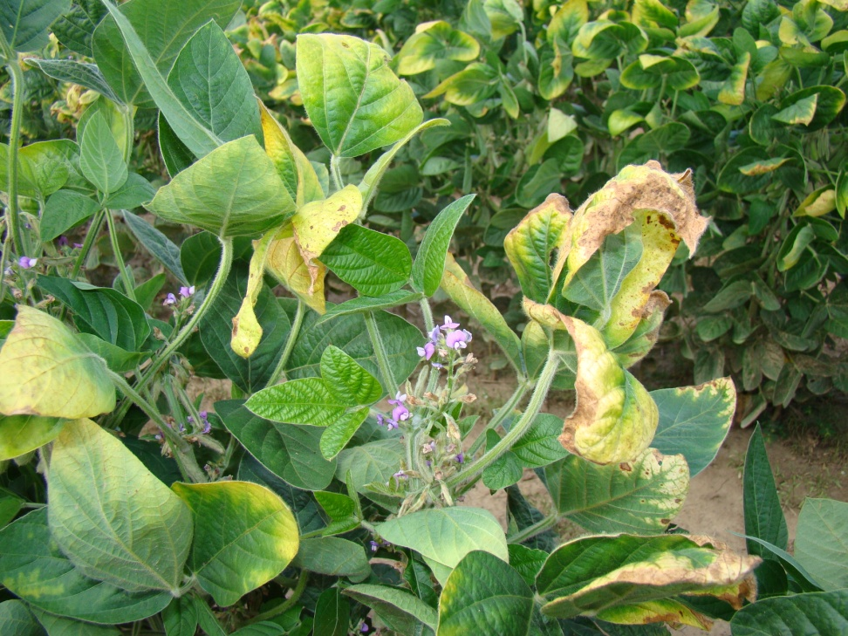
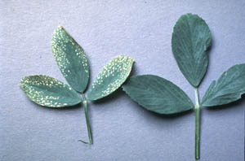

Slide 8
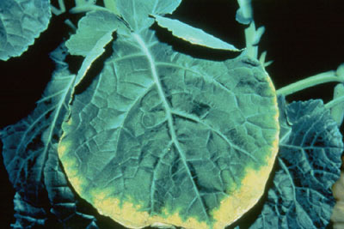
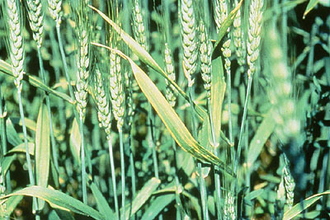

Slide 9
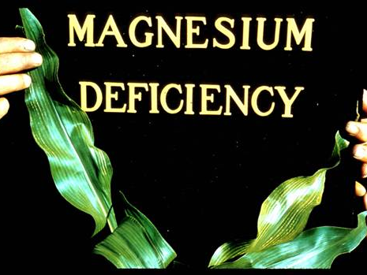
Magnesium Deficiency
Magnesium is mobile in the plant: Lower/Older Leaves
Yellowing between the veins
Reddish Purple from leaf edge moving inward, cotton soybean canola

Slide 10
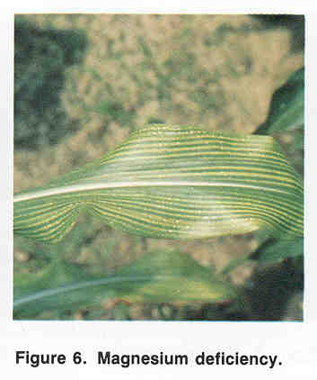
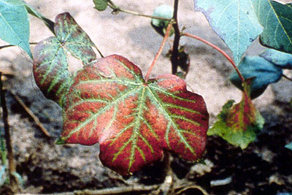

Slide 11
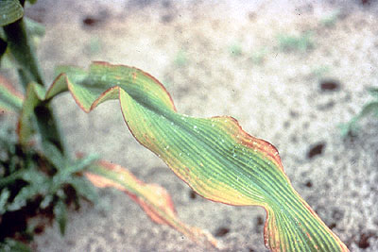
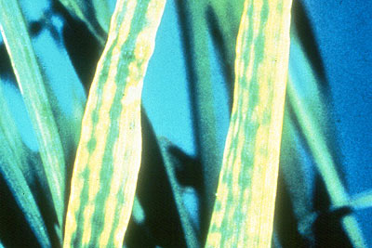

Slide 12
Magnesium is required for crops to capture the sun’s energy for growth and production. Its functions include phosphate metabolism, plant respiration, and activation of enzyme systems. Magnesium can be added to deficient soils by applying Mg-containing fertilizers or dolomitic limestone. Dolomitic limestone contains both Ca and Mg carbonates (for neutralizing value), whereas calcitic limestone contains only Ca carbonate. Availability of Mg is often related to soil pH. Other situations also increase needs for Mg: sandy soils with low cation exchange capacity, low Mg-supplying power, and a high Mg leaching potential; application of calcitic limestone on low Mg soils; crops with high Mg requirements; high application rates of ammonium-N and K; soil test levels below 50 to 100 lb/A exchangeable Mg.

Slide 13
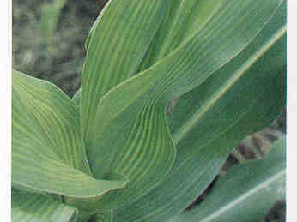
Sulfur Deficiency
Sulfur is Immobile in the plant: Upper/Newer leaves.
Similar to nitrogen, yellowing more uniform over leaf.
Intervienal Chlorosis.

Slide 14
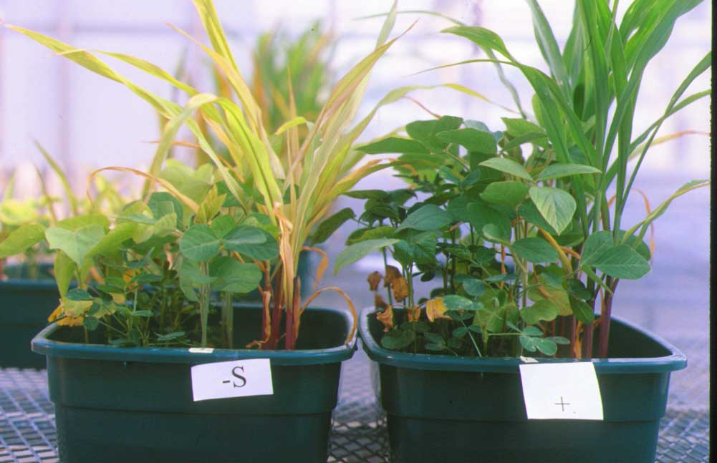
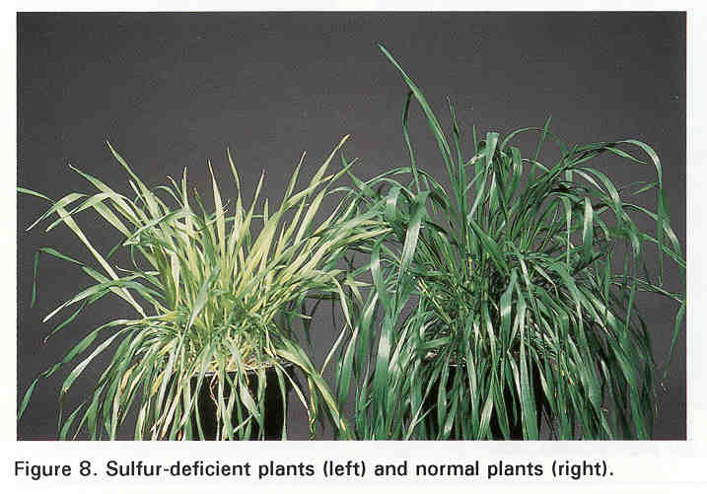

Slide 15
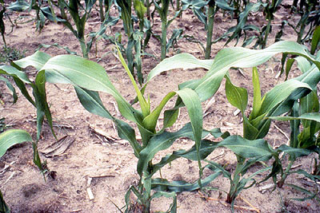
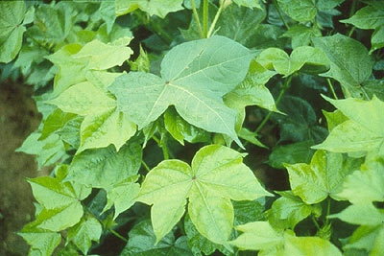

Slide 16
Sulfur is becoming more of a limiting nutrient in crop production than in the past, for several reasons: higher crop yields require more S; increased use of high analysis fertilizers containing little of no S; reduced amounts of atmospheric S fallout from the sky; and reduced soil S reserves from organic matter losses due to mineralization and erosion. Most S in the soil is tied up in organic matter and cannot be used by the plant until it is converted to the sulfate (SO₄) form by soil bacteria. That process is known as mineralization. Sulfur can be applied as broadcast or banded fertilizer material or applied through irrigation systems (furrow and sprinkler). Sulfur is also an important nutrient for proper nutrition of forage crops that will be consumed by livestock

Slide 17
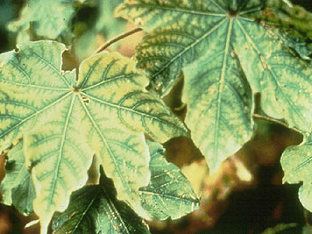
Zinc Deficiency
Zinc relatively immobile in plant: Upper/Newer leaves
Purple margins, inward purple blotching,
bleached bands on either side of midrib near base, intervienal chlorosis
Acidic, Sandy soils, Calcareous pH>8

Slide 18
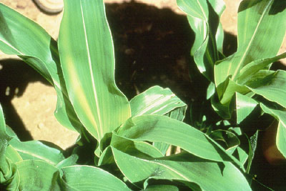
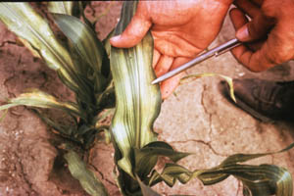

Slide 19
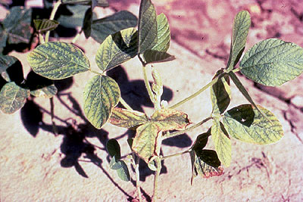
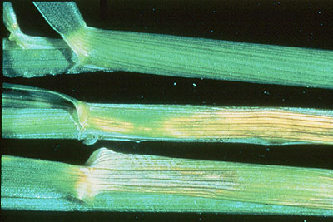

Slide 20
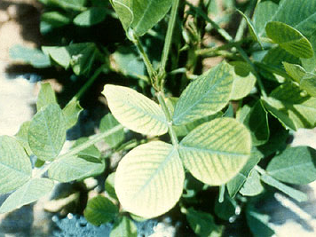
Iron Deficiency
Iron is immobile in the plant: Upper/Newer leaves
Intervienal chlorosis, stripes narrower than zinc and extend full length of leaf
Calcareous Soils pH >8

Slide 21
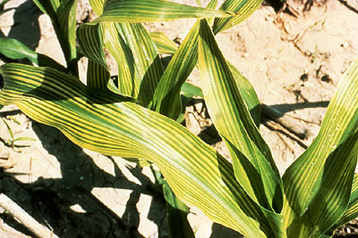
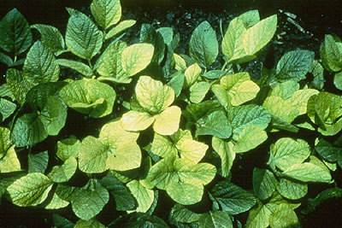

Slide 22
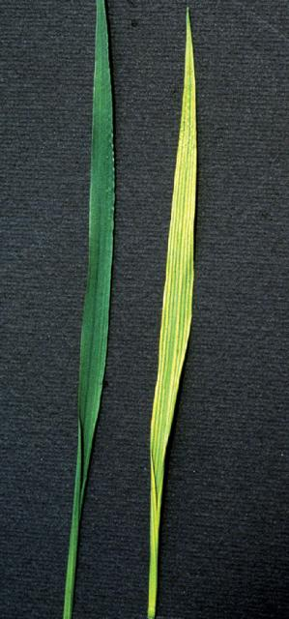
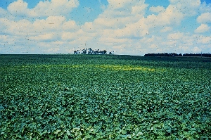

Slide 23
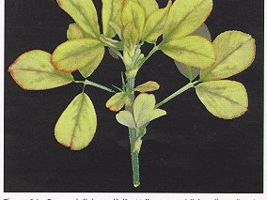
Boron Deficiency
Boron is immobile in the plant: Upper/Newer leaves
Wide range of symptoms; necrosis of young leaves and terminal buds,
reddening in some legumes and canola
Well drained sandy soils

Slide 24
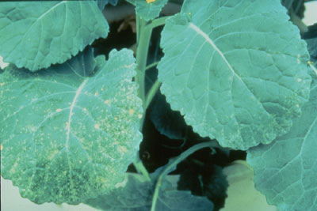
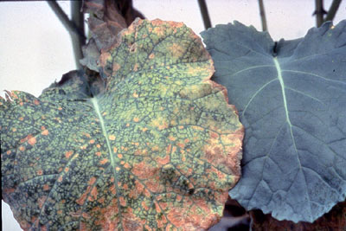

Slide 25
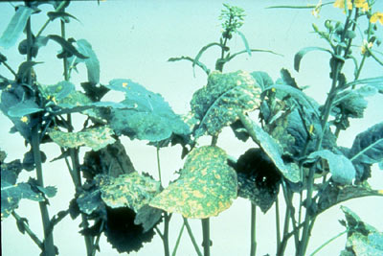
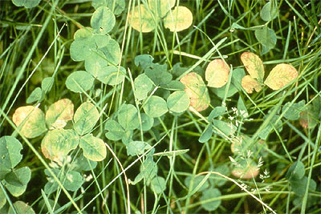

Slide 26
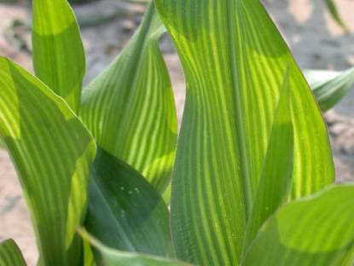
Manganese Deficiency
Manganese is relatively immobile in plant, but can move in xylem sap.
Interveinal chlorosis, very similar to Fe, Mg, N.
Severe deficiencies have brown specs and bronzing
Limited at high pH, Calcareous soils.

Slide 27
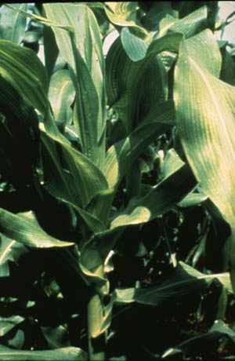
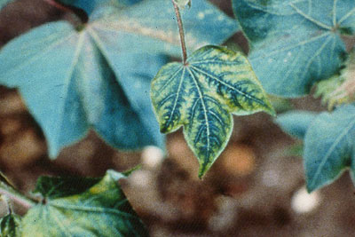

Slide 28
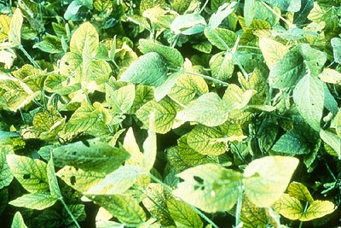
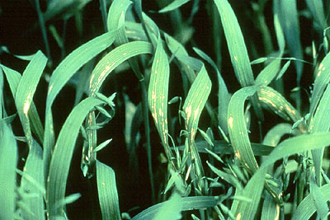

Slide 29
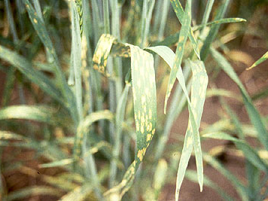
Chlorine Deficiency
Chlorine is mobile in the plant: Lower/Older leaves
Reduced growth, necrotic and chlorotic spots, bronzing in extreme.
Upper leaves will wilt.
Sandy soils

Slide 30
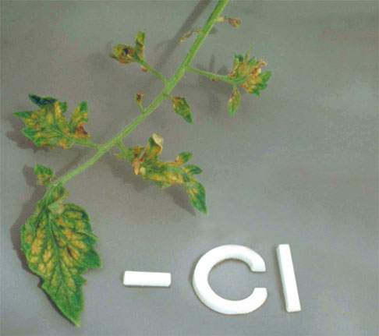
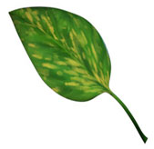

Slide 31
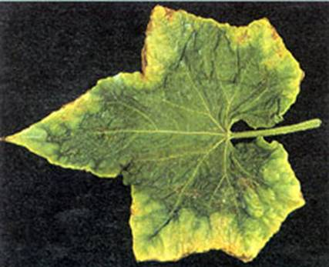
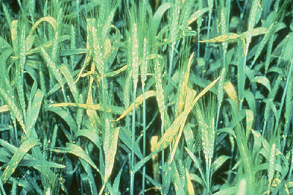

Slide 32
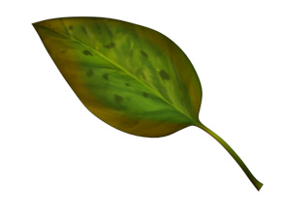
Molybdenum Deficiency
Molybdenum is readily translocated; whole plant
Related to N metabolism, yellowing, stunting, interveinal mottling
Cupping of upper leaves
Soil with low pH and high Fe and Al.

Slide 33
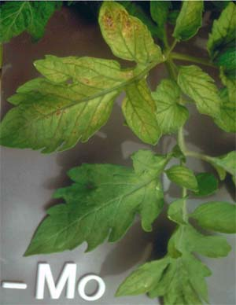
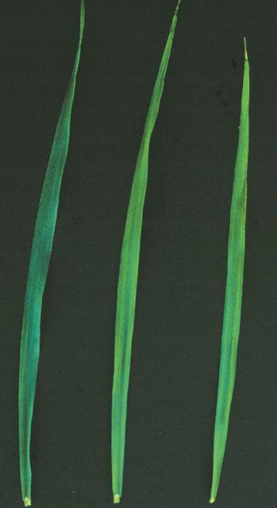

Slide 34
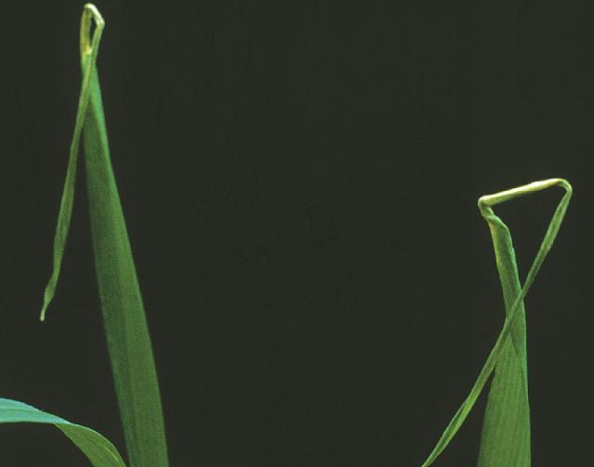
Copper Deficiency
Copper is Immobile in the plant: Upper/Newer leaves
Stunted growth, terminal dieback, necrosis of meristem, delayed flowering
New leaves uniformly pale

Slide 35



