Slide 1
Turfgrass Fertility
Justin Quetone Moss
Assistant Professor
Turfgrass Research and Extension
Department of Horticulture & Landscape Architecture

Slide 2
Turfgrass
Grasses that form a contiguous groundcover and persist under regular mowing and traffic
Turf is grown either for aesthetic value or functional value or both
All turf requires some form of maintenance
Economic thresholds for turfgrass are not determined by yield but by consumer expectations

Slide 3
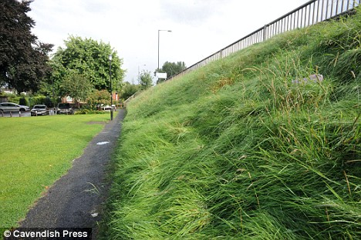
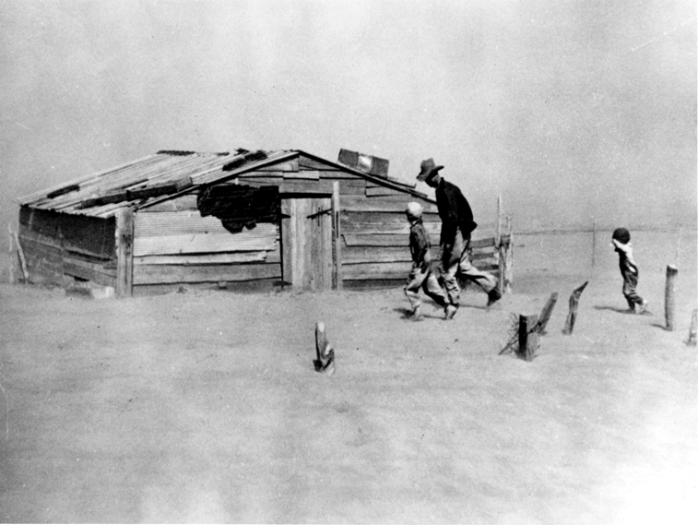
Benefits of Grasses
Functional
Soil erosion control and dust stabilization
Cooling effect

Slide 4
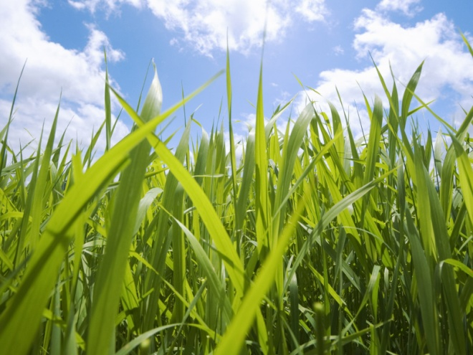
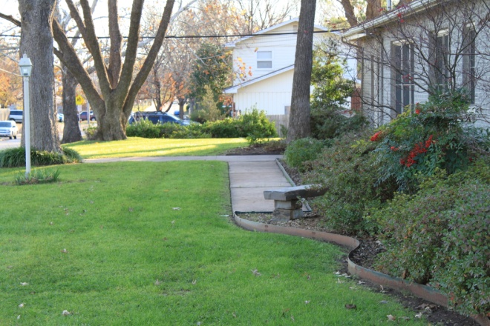
Benefits of Grasses
Aesthetic
Beauty
Complementary
Property Values

Slide 5
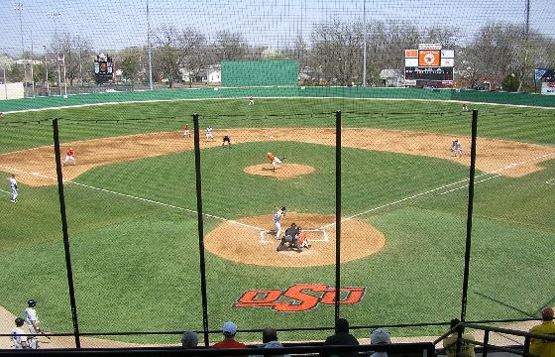
Benefits of Grasses
Recreational
Safe playing surfaces

Slide 6
Turfgrass
Cool-season grasses are also called C3 grasses
Warm-season grasses are also called C4 grasses
Why?

Slide 7
Turfgrass
Based on their photosynthetic pathways
C3 – first stable product formed following CO2 fixation is phosphoglyceric acid (PGA), a three-carbon compound
C4 – first stable product formed following CO2 fixation is oxaloacetate (OAA) which is converted into malate or aspartate, four-carbon compounds

Slide 8
Types of Turfgrass
Examples of cool-season or C3 grasses
Bluegrasses, fescues, bentgrasses, and ryegrasses
Examples of warm-season or C4 grasses
Bermudagrasses, zoysiagrasses, buffalograss, blue grama, St. Augustine, centipedegrass, bahiagrass, and seashore paspalum

Slide 9
Turfgrass Adaptation
C3 Grasses - Temperate Regions
Transition Zone
C4 Grasses - Subtropical Regions

Slide 10
Turfgrass root growth
Cool-season grasses
Majority of root growth in spring and fall in Oklahoma, roots dieback in summer
Warm-season grasses
Majority of root growth in late spring/summer in Oklahoma, no root growth in winter

Slide 11
Turfgrass
Macronutrients, non-mineral essential
C, H, O
Primary nutrients, primarily from fertilization
N, P, K
Secondary nutrients, typically sufficient for turf
Ca, Mg, S,
Micronutrients, typically sufficient for turf
Fe, Mn, Cu, Cl, Zn, B, Mo

Slide 12
Nitrogen
N application gives you the fastest, most noticeable response – turns green!
More N is not always better
Excess N may promote shoot growth at the expense of root growth
We want to focus on a healthy root system

Slide 13
Nitrogen
N application can affect disease development
Sometimes excess N will increase disease development
Other times, a correct N application can help alleviate disease symptoms
Example: Brown patch likes high N, Dollar spot likes low N

Slide 14
N Fertility
Soil test?
Tissue test?
Sensors?

Slide 15
N Fertility
Example program for bermudagrass on a well maintained lawn
Mid-April– 0.5 lbs N/1,000 sq ft
May – 1 lb N/1,000 sq ft
June – 1 lb N/1,000 sq ft
July – 1 lb N/1,000 sq ft
August – 1 lb N/1,000 sq ft
September – 0.5-0.75 lbs N/1,000 sq ft
October – Mid-April – no N applied
We would try to apply 4-5 lbs N/1,000 sq ft/year, depending on conditions

Slide 16
N Fertility
Example program for tall fescue in partial shade on a well maintained lawn
March – 0.5 lbs N/1,000 sq ft, slow release
April – 0.5 lbs N/1,000 sq ft
Early May – 0.25 lb N/1,000 sq ft, fast release
June – not recommended
July – not recommended
August – not recommended
September – 1.0 lbs N/1,000 sq ft, fast release
October – 1.0 lbs N/1,000 sq ft, slow release
November – February – 0.5 lbs N/1,000 sq ft if needed, slow release
We would try to apply 3-4 lbs N/1,000 sq ft/year, depending on conditions

Slide 17
Fertilizer Bag
If you buy a bag of 20-12-15 fertilizer, it contains:
20% N
12% P₂O₅
15% K₂O
53% other materials; this could be filler, inert materials, or if listed, other nutrients

Slide 18
Fertilizer Bag
If you purchase 40 lb bags of 20-12-15 fertilizer and you need to apply 1 lb N/1,000 sq ft to 20,000 sq ft of bermudagrass turf:
How many lbs actual fertilizer do you need to apply per 1,000 sq. ft.
How many lbs of fertilizer do you need for this job?
How many bags do you need on hand?

Slide 19
Fertilizer Bag
If you purchase 40 lb bags of 20-12-15 fertilizer and you need to apply 1 lb N/1,000 sq ft to 20,000 sq ft of bermudagrass turf:
How many lbs actual fertilizer do you need to apply per 1,000 sq. ft.
1 lb N 1 lb fertilizer
5 lbs fertilizer
X
=
1,000 sq ft 0.2 lb N
1,000 sq ft

Slide 20
Fertilizer Bag
If you purchase 40 lb bags of 20-12-15 fertilizer and you need to apply 1 lb N/1,000 sq ft to 20,000 sq ft of bermudagrass turf:
How many lbs of fertilizer do you need for this job?
5 lbs fertilizer/1,000 sq ft * 20,000 sq ft = 100 lbs fertilizer
How many bags do you need on hand?
100 lbs fertilizer/40 lb bags = 2.5 bags

Slide 21
N Carriers
Quick-release or soluble
Synthetic inorganic
Ammonium nitrate – 33% N
Ammonium sulfate – 21% N
Calcium nitrate – 16% N
Potassium nitrate – 13% N
Synthetic organic
Urea – 45% N
Should be lightly “watered-in” to prevent inorganic salt burn and urea volatilization

Slide 22
N Carriers
Slow-release or water-insoluble
Synthetic organic
Urea formaldehyde (UF) – 18-40% N
Isobutylidene Diurea (IBDU) – 31% N
Coated
Sulfur-coated urea (SCU) – 15-45% N
Plastic or Poly-resin-coated urea – 10-44% N
Natural organic
Milorganite – 6% N
Nature Safe, Ringer, many others – 5-18% N (from fish meal, bone meal, poultry feather meal, etc.)

Slide 23
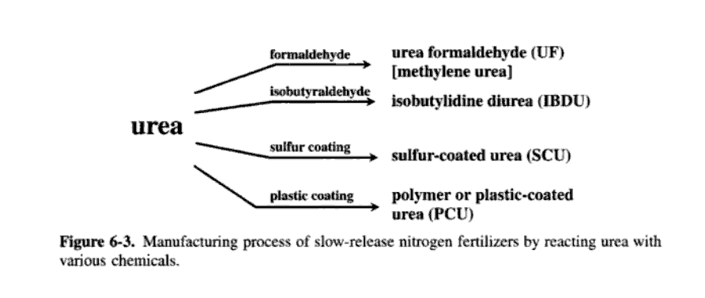
McCarty et al., 2003. Fundamentals of turfgrass and agricultural chemistry. p. 238.

Slide 24
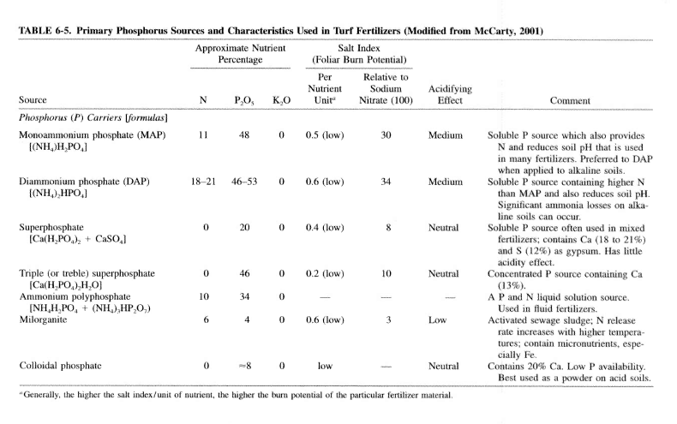
McCarty et al., 2003. Fundamentals of turfgrass and agricultural chemistry. p. 243.

Slide 25
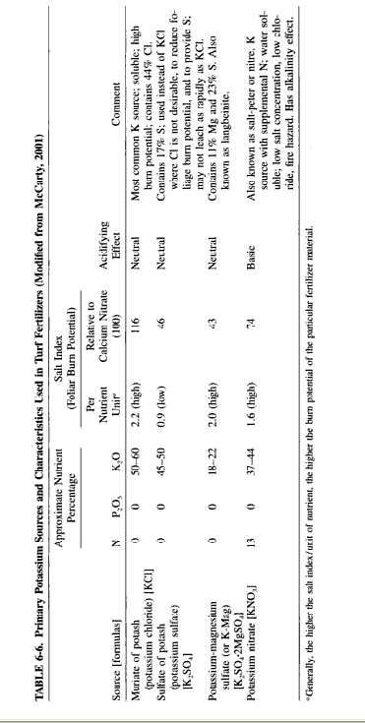
McCarty et al., 2003. Fundamentals of turfgrass and agricultural chemistry. p. 245.

Slide 26
Turf Fertilizers
Other Fertilizers
Gypsum (Calcium sulfate) – 24% S and 41% calcium oxide; sodic soils (Na), little effect on soil pH
Calcium nitrate – 19% Ca and 1.5% Mg, N has high burn potential
Dolomitic limestone – increase soil pH, 22% Ca and 11% Mg
Magnesium sulfate (Epsom salt) – 13-23% S and 10-17% Mg, little effect on soil pH

Slide 27
Turf Fertilizers
Other Fertilizers – many turf fertilizers have micronutrients
Fe – many times turf managers use Fe for the green response
Typically chelated Fe, also Ferrous sulfate
Zn – Zinc sulfate, Zinc chelate, Zinc oxide
Mn – Manganese sulfate, Manganese oxide
Cu – Copper sulfate, Copper oxide, Copper chelate
B – borax, boric acide, solubor
Mo – Ammonium molybdate, Sodium molybdate
Cl – ammonium chloride, calcium chloride, Mg chloride, K chloride

Slide 28
Questions?
Justin Quetone Moss
405-744-5729
mossjq@okstate.edu

