Slide 1
Fertilizer Calculations

Slide 2
Overview
Soil Test Recommendations
Total Nutrient Needs
Available Nutrient Sources
Concentration of Nutrient in each source
Calculating price per lb of Nutrient
Blending
Multiple resolution Quarters, Acres, 1000 ft2
Conversions!!!

Slide 3
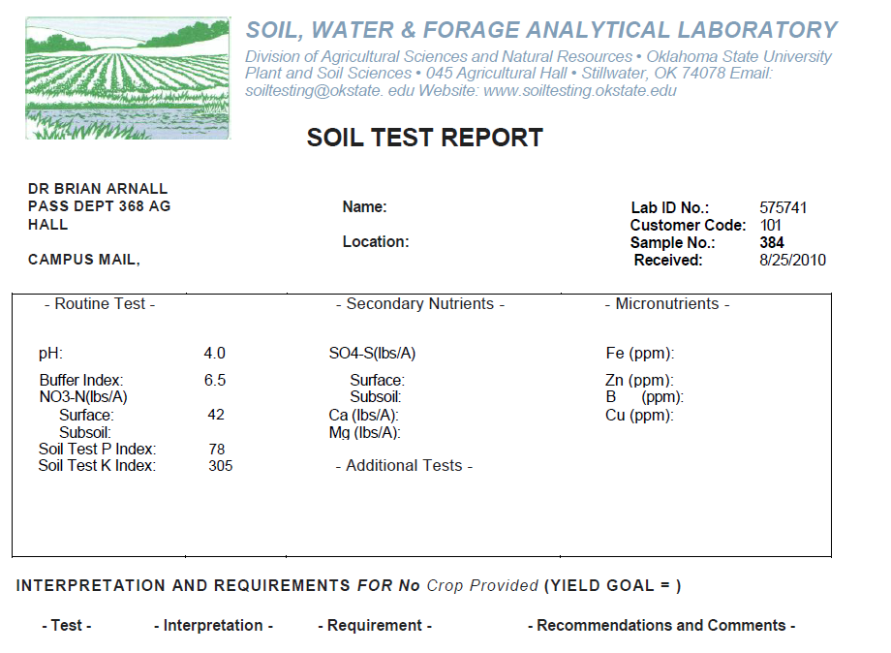
Soil Test
http://www.soiltesting.okstate.edu/Interpretation.htm

Slide 4
Recommendation / Interpretation
Depends upon Yield and OM for Mobile
Depends upon Fertilization Concept for Immobile i.e. Sufficiency vs Maintenance
OSU = Sufficiency, Private = Maintenance, KSU = option.
Sufficiency, Fertilize the plant.
Maintenance, Fertilize the soil.
Nutrient Drawdown.

Slide 5
Fertilizer Sources
http://npk.okstate.edu/nitrogen/fertilizers/index.htm http://npk.okstate.edu/phosphorus/fertilizers/index.htm http://npk.okstate.edu/potassium/fertilizers/index.htm
Anhydrous Ammonia 82-0-0
Urea 46-0-0
UAN 28 or 32-0-0
Di-ammonium phosphate 18-46-0
Mono-ammonium phosphate 11-52-0
Ammonium poly-phosphate 10-34-0
Potash 0-0-62

Slide 6
Calculating Price per lb
http://npk.okstate.edu/index.htm
Price Traditionally reported in $/ton material
82-0-0 @ $500 per ton
2000 * .82 = 1640 lbs N/ton
500 / 1640 = $0.305 / lb N
$500
1 Ton AA
1 lbs AA
1 Ton AA
2000 lbs AA
0.82 lbs N

Slide 7
Yield Goal Calculation
Use Handbook/PeteSheet to determine total N needs.
Subtract residual soil N from total need.
Wheat Yield goal 60 bu = 125 lb N
Soil Test Sur NO₃ = 15 lb N
Total Fertilizer N needs = 110 lb N
What about Subsoil N?

Slide 8
Sufficiency Calculation
Use Handbook/PeteSheet to determine P and K needs based on STP and STK.
Winter Wheat STP = 20 STK = 200
P Suff = 80 K Suff = 95
P needs = 40 lbs P₂O₅ K needs = 20 lbs K₂O
What if STP was 15?

Slide 9
Need 110 lbs N/ac
Source Urea : 46-0-0
110 lbs N ac / .46 % N = 239.1 lbs Urea
Have 80 acres 239.1 *80 19130 lbs Urea/field
Order in Tons Urea /acre 19130/2000 = 9.56
110 lbs N
1 lb Urea
acre
0.46 lbs N
110 lbs N
1 lb Urea
80 acres
Ton
acre
0.46 lbs N
Field
2000 lbs

Slide 10
Multiple Nutrients
Using Urea and DAP N= 110 lbs P = 40 lbs P₂O₅
What do you figure first N or P?
Lbs DAP
40/.46 = 86.9
86.9 * .18 = 15.6
110-15.65 = 94.35
94.36 / .46 = 205.1
87 Lbs DAP/ac and 205.1 lbs Urea/ac

Slide 11
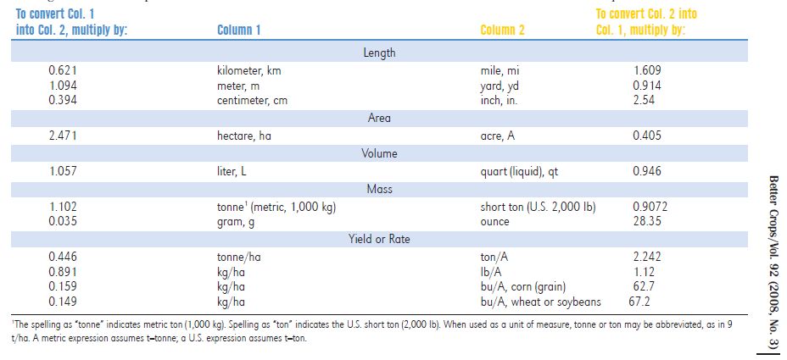
Conversions

Slide 12
Unit Conversion Factors
Area / Distance | 1 | inch | = | 2.54 | cm
 | 1 | foot | = | 30.48 | cm
 | 1 | meter | = | 39.36 | inches
 | 1 | meter | = | 3.28 | feet
 | 1 | Foot sq. | = | 0.0929 | meter sq
 | 1 | ac | = | 4046 | meter sq
 | 1 | ac | = | 43560 | ft sq
 | 1 | ha | = | 10000 | m2
 | 1 | ac/fur/slice | = | 2000000 | lb soil
Unit Conversion Factors
Liquid | 1 | Gal Water | = | 8.34 | lb
 | 1 | Gal UAN | = | 10.67 | lb
 | 1 | Gal Solution | = | 3785 | mL
 | 1 | gallon | = | 4 | Quarts
 | 1 | Quart | = | 946 | mL
 | 1 | Quart | = | 2 | Pint
 | 1 | Pint | = | 473 | mL
 | 1 | fl oz | = | 29.574 | mL
 | 1 | gallon | = | 127.98 | fl oz
Unit Conversion Factors
Yield / Weight / Mass | 1 | lb Seed Cotton | = | 0.33 | lb Lint
 | 1 | bale | = | 480 | lb Lint
 | 1 | bu |  | 48 | lb
 | 1 | bu | = | 56 | lb
 | 1 | bu | = | 60 | lb
 | 1 | lb | = | 0.454 | kg
 | 1 | ha | = | 2.469125 | ac
 | 1 | ton | = | 2000 | lb
 | 1 | ton | = | 908 | kg
 | 1 | Mg | = | 1000 | kg
 | 1 | lb | = | 16 | oz
 | 1 | oz | = | 28.3495 | grams
 | 1 | lb | = | 454 | grams

