Slide 1
Soil Long-term Nutrient Dynamics
Under No-Till
A Farm Experience in Brazil
Romulo Pisa Lollato

Slide 2
Climate characteristics
Temperature:
Average: 65.5ºF or 18.6ºC
Winter average < 64.4F or 18C
Summer average > 71.6F or 22C
Altitude: 2690 feet or 820m
Climate: Humid Subtropical
Rainfall
Total year: 74 inches or 1879mm

Slide 4
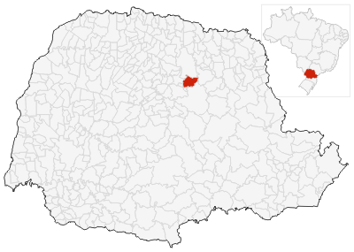
Farm History
Santo Expedito Farm
Marco Antônio Lollato (Farmer)
Land acquired in 1978
Total area - 277 acres (112 ha)
- Cropland: 218 acres (88ha)
- Natural vegetation (forest): 59 acres (24ha)
- Tamarana – PR, Brazil
- Lat. 23°68`S
- Rhodic Hapludox

Slide 5
HISTORY
CROP ROTATION
- 1978: half of the area in cropland and half in native weeds and bushwoods
- whole area was cleaned, except legal reserve (20%)
- 1978 – 1982: corn/dry beans/lupine – conventional till
- 1983 – 1985: corn/dry beans/lupine – no-till
- 1986 – today: summer - two year soybean
- one year corn/dry beans
winter – wheat/triticale/oat – no-till
no-till

Slide 6
HISTORY
LIMING
1980 - 1988: Dolomitic Aglime
- 4,000 Kg/ha one in each two years
1988 – 2000: Calcitic Aglime
- 2,000 Kg/ha one in each four years

Slide 7
CONSERVATION HISTORY
- 1978 – Cropland terraced
- 1982 – Started no-till
half of the terraces were removed (alternating)
- 1984 – Removed half of the remaining terraces (alternating)
- 1986 – All remaining terraces removed
- Use of high biomass corn, soybean, dry bean, wheat, oat and triticale varieties (seeking high straw production)
- 2007 – Plowing small area to correct soil microrelieve – water erosion

Slide 8
Soil Organic Matter, pH
and main nutrients levels
at the Santo Expedito farm

Slide 9
Soil Samples
- Depth: 0 – 8 inches (0 – 20 cm)
- One representative sample of five to eight subsamples, to each 44 acres (approximately)
- 5 representative samples for the whole area

Slide 16
SOM, pH and main nutrients levels at the Santo Expedito farm. Tamarana, PR, Brazil. 1980 - 2006.
 | N.F. | Till (3 yrs) | No Till (5 yrs) | No Till (26 yrs)
O.M. (%) | 5.6 | 3.3 | 4.1 | 5.6
P (ppm) | 1 | 5 | 8 | 17
K (ppm) | 142 | 85 | 160 | 160
Ca (mEq/100g) | 3.9 | 2.6 | 5.1 | 5
Mg (mEq/100g) | 1.7 | 1.6 | 2.5 | 2.7
pH (CaCl₂) | 4.1 | 5.3 | 5.4 | 5.5
O.M – Organic matter
N.F. – Natural Forest

Slide 21
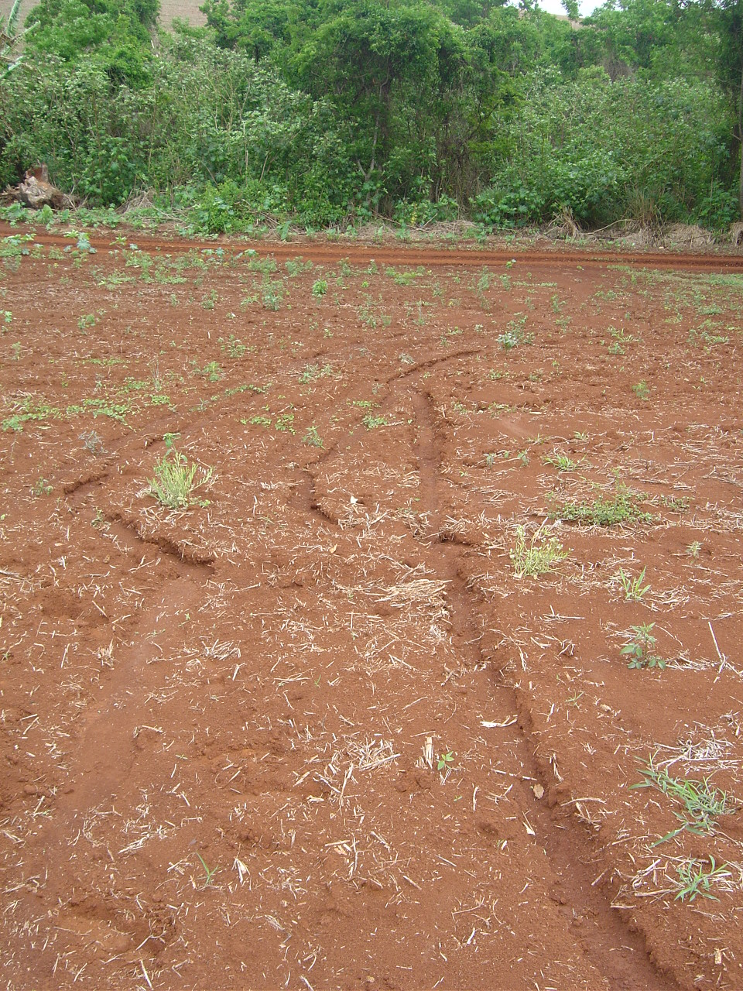
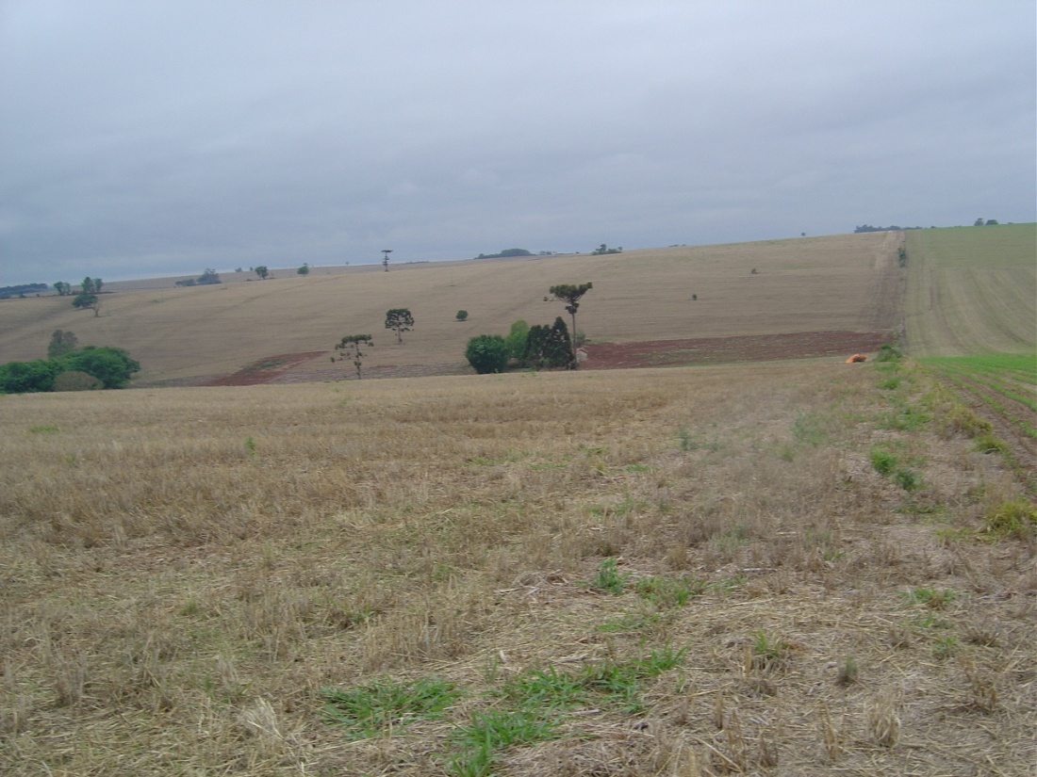

Slide 22
Romulo Pisa Lollato
romulo.lollato@okstate.edu
romuloplollato@hotmail.com
405 385 1982

